Slide 1
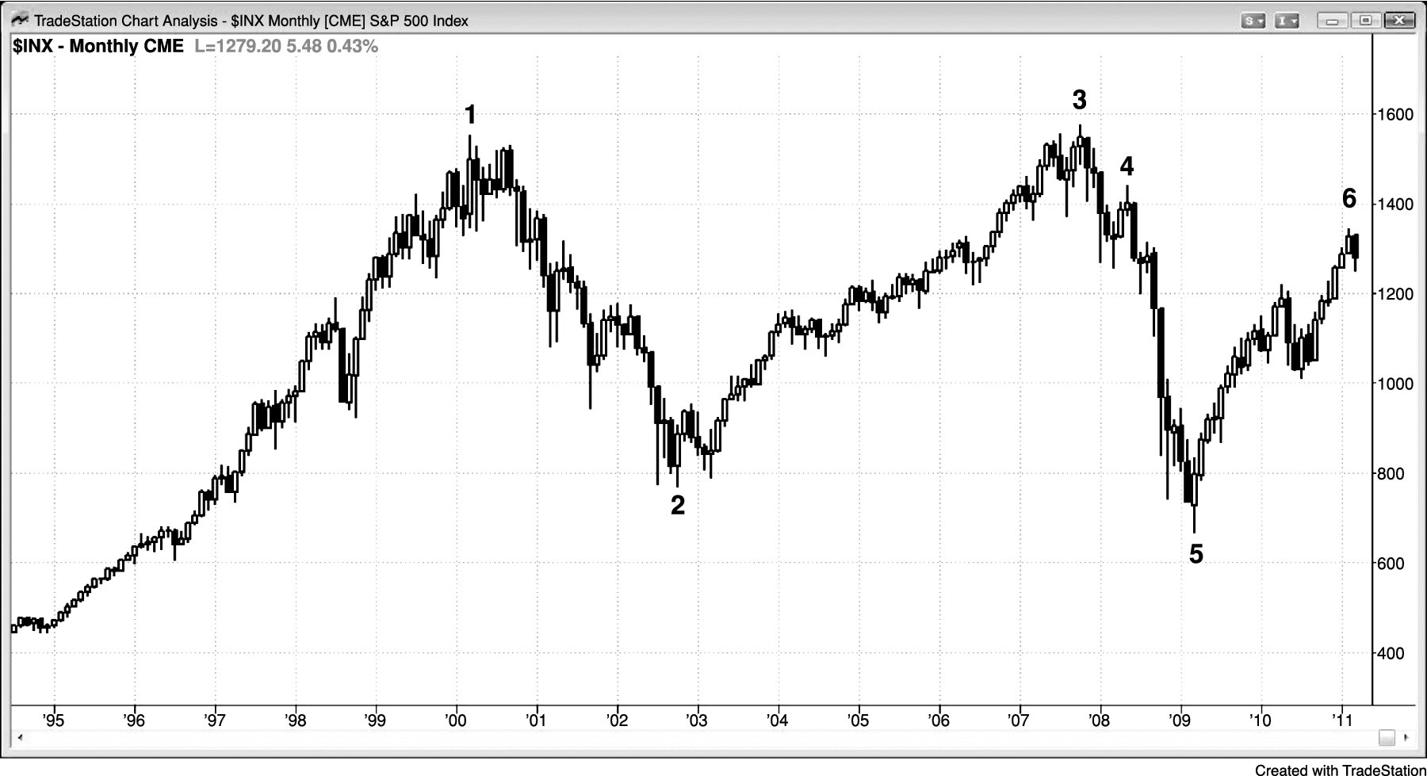
FIGURE 20.1 Monthly S&P Cash Index in a 12-Year Trading Range

Slide 2
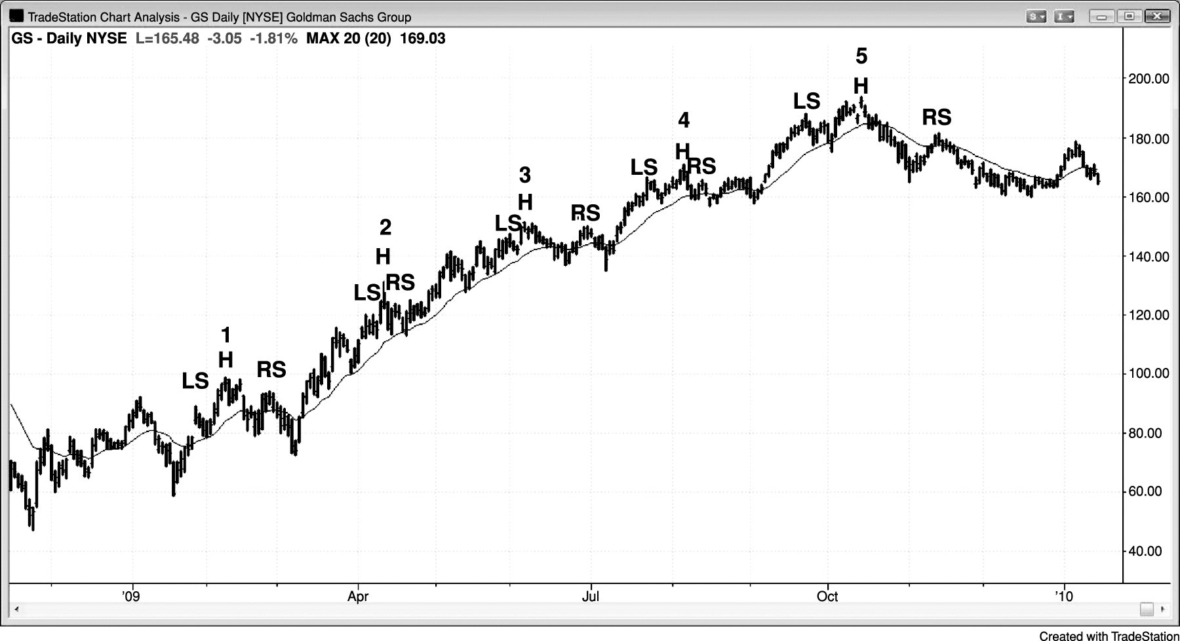
FIGURE 20.2 Most Head and Shoulders Tops Are Bull Flags

Slide 3
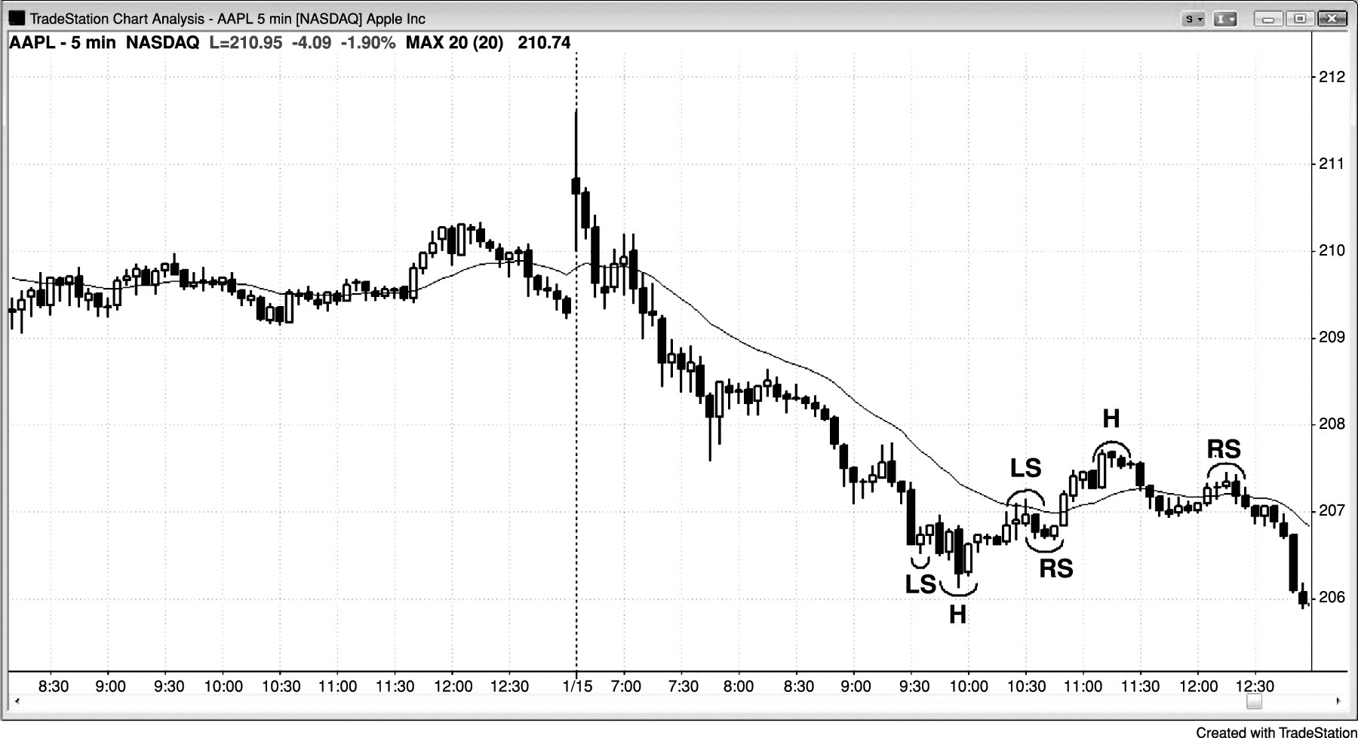
FIGURE 20.3 Head and Shoulders Top and Bottom Bear Flag

